Slide 1
UVa 11997 K Smallest Sums

Slide 2
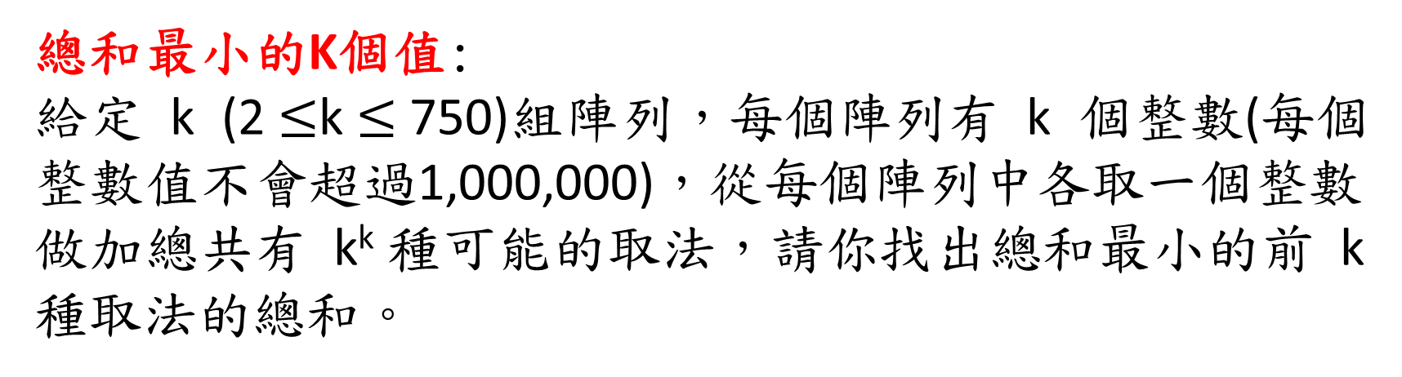
Uva 11997 K Smallest Sums (Time Limit: 1 second)
總和最小的K個值:
給定 k (2 $≤$k $≤$750)組陣列，每個陣列有 k 個整數(每個整數值不會超過1,000,000)，從每個陣列中各取一個整數做加總共有 k^{k} 種可能的取法，請你找出總和最小的前 k 種取法的總和。

Slide 3
UVa 11997 K Smallest Sums
Input
Output
3
1 8 5
9 2 5
10 7 6
2
1 1
1 2
9=1+2+6
10=1+2+7
12=1+5+6
Test Case #1
9 10 12
2 2
2=1+1
2=1+1
Test Case #2

Slide 4
UVa 11997 K Smallest Sums
Input
Output
3
1 8 5
9 2 5
10 7 6
2
1 1
1 2
9=1+2+6
10=1+2+7
12=1+5+6
Test Case #1
9 10 12
2 2
2=1+1
2=1+1
Test Case #2

Slide 5
UVa 11997 K Smallest Sums
Input
Output
3
1 8 5
9 2 5
10 7 6
2
1 1
1 2
9=1+2+6
10=1+2+7
12=1+5+6
Test Case #1
9 10 12
2 2
2=1+1
2=1+1
Test Case #2

Slide 6
UVa 11997 K Smallest Sums
Input
Output
3
1 8 5
9 2 5
10 7 6
2
1 1
1 2
9=1+2+6
10=1+2+7
12=1+5+6
Test Case #1
9 10 12
2 2
2=1+1
2=1+1
Test Case #2

Slide 7
UVa 11997 K Smallest Sums
Input
Output
3
1 8 5
9 2 5
10 7 6
2
1 1
1 2
9=1+2+6
10=1+2+7
12=1+5+6
Test Case #1
9 10 12
2 2
2=1+1
2=1+1
Test Case #2

Slide 8
UVa 11997 K Smallest Sums
Input
Output
3
1 8 5
9 2 5
10 7 6
2
1 1
1 2
9=1+2+6
10=1+2+7
12=1+5+6
Test Case #1
9 10 12
2 2
2=1+1
2=1+1
Test Case #2

Slide 9
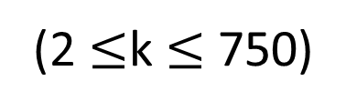
Sample Input
3
1 8 5
9 2 5
10 7 6
2
1 1
1 2
(2 $≤$k $≤$750)
k
Sample Output
K rows, 每row有k個整數
Test Case #1
9 10 12
2 2
Test Case #2
總和最小的K個值(漸增順序型式)
Test Case #1
Test Case #2
1 8 5
9 2 5
10 7 6
9=1+2+6
10=1+2+7
12=1+5+6
1 1
1 2
2=1+1
2=1+1
15

Slide 10

Solution
A Priority Queue (Min Heap) Application
Our solution:
Time Complexity: O($k^{k}$) $→$O($k^{2}\log{k}$)
Space Complexity: O($k^{2}$) $→$O(k)

Slide 11
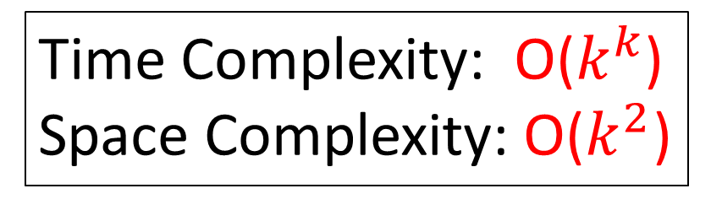
UVa 11997 K Smallest Sums
Brute Force:
From all the $k^{k}$ possible cases, choose the k smallest sums.
Time Complexity: O($k^{k}$)
Space Complexity: O($k^{2}$)
For loop1=1 to k do
For loop2=1 to k do
For loop3=1 to k do
.
.
.
For loopk=1 to k do
. . . // k-nested loop
End
End
End
End
Inefficient !!
Program-like

Slide 12
UVa 11997 K Smallest Sums
Solution: (Example for k=5)
A: 5 7 13 16 19
13 15 15 16 17
D: 5 7 9 11 13
B: 6 9 14 18 22
K smallest sums
K smallest sums
18 20 20 20 21
11 13 14 16 19
E: 1 2 3 4 5
C: 2 4 7 8 9
K smallest sums
K smallest sums
13 15 15 16 17
Result
19 20 21 21 21

Slide 13
A Subproblem:
A Special Merging Two Sorted Lists A and B into a List C
Spec-Merge(A, B, C, k)
A: 5 7 13 16 19
(k=5)
B: 6 9 14 18 22
C: 11 13 14 16 19
(List C stores 5 smallest sums.)

Slide 14
Special Merging處理過程

Slide 15
Step 1
A, B: Two sorted lists
PQ: Priority queue
(i): i is an index of list B
DEL-min: delete min
INS: insert
[0] [1] [2] [3] [4]
A: 5 7 13 16 19
+
+
+
+
+
B: 6 9 14 18 22
PQ: 11(0) 13(0) 19(0) 22(0) 25(0)
DEL-min(PQ)
A[0]+B[0]
A[0]+B[1]
C: 11(0)
INS(PQ):
11 - B[0] + B[0+1] = 11 – 6 + 9 = 5 + 9 = 14 (1)
PQ: 13(0) 19(0) 22(0) 25(0) 14(1)

Slide 16
Step 2
A, B: Two sorted lists
PQ: Priority queue
(i): i is an index of list B
DEL-min: delete min
INS: insert
[0] [1] [2] [3] [4]
A: 5 7 13 16 19
+
+
+
+
+
B: 6 9 14 18 22
PQ: 13(0) 19(0) 22(0) 25(0) 14(1)
DEL-min(PQ)
C: 11(0) 13(0)
A[1]+B[0]
A[1]+B[1]
INS(PQ):
13 - B[0] + B[0+1] = 13 – 6 + 9 = 7 + 9 = 16 (1)
PQ: 19(0) 22(0) 25(0) 14(1) 16(1)

Slide 17
Step 3
A, B: Two sorted lists
PQ: Priority queue
(i): i is an index of list B
DEL-min: delete min
INS: insert
[0] [1] [2] [3] [4]
A: 5 7 13 16 19
+
+
+
+
+
B: 6 9 14 18 22
PQ: 19(0) 22(0) 25(0) 14(1) 16(1)
DEL-min(PQ)
A[0]+B[1]
A[0]+B[2]
C: 11(0) 13(0) 14(1)
INS(PQ):
14 - B[1] + B[1+1] = 14 – 9 + 14 = 5 + 14 = 19 (2)
PQ: 19(0) 22(0) 25(0) 16(1) 19(2)

Slide 18
Step 4
A, B: Two sorted lists
PQ: Priority queue
(i): i is an index of list B
DEL-min: delete min
INS: insert
[0] [1] [2] [3] [4]
A: 5 7 13 16 19
+
+
+
+
+
B: 6 9 14 18 22
PQ: 19(0) 22(0) 25(0) 16(1) 19(2)
DEL-min(PQ)
C: 11(0) 13(0) 14(1) 16(1)
A[1]+B[1]
A[1]+B[2]
INS(PQ):
16 - B[1] + B[1+1] = 16 – 9 + 14 = 7 + 14 = 21 (2)
PQ: 19(0) 22(0) 25(0) 16(1) 19(2) 21(2)

Slide 19
Step 5
A, B: Two sorted lists
PQ: Priority queue
(i): i is an index of list B
DEL-min: delete min
INS: insert
[0] [1] [2] [3] [4]
A: 5 7 13 16 19
+
+
+
+
+
B: 6 9 14 18 22
PQ: 19(0) 22(0) 25(0) 19(2) 21(2)
DEL-min(PQ)
C: 11(0) 13(0) 14(1) 16(1) 19(0)
A[2]+B[0]
A[2]+B[1]
INS(PQ):
19 - B[0] + B[0+1] = 19 – 6 + 9 = 13 + 9 = 22 (1)
PQ: 22(0) 25(0) 16(1) 19(2) 21(2) 27(1)

Slide 20
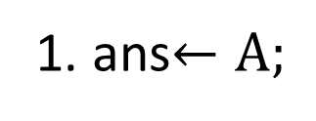
Example: k=5
Input: 5 個sorted arrays A, B, C, D, E
Ouput: sorted array ans (存k smallest sums)
處理步驟:
1. ans$←A;$
2. Spec-Merge(ans, B, ans, k); // ans與 B Spec-Merge 結果存於ans
3. Spec-Merge(ans, C, ans, k); // ans與 C Spec-Merge 結果存於ans
4. Spec-Merge(ans, D, ans, k); // ans與 D Spec-Merge 結果存於ans
5. Spec-Merge(ans, E, ans, k); // ans與 E Spec-Merge 結果存於ans
6. 輸出ans內容;

Slide 21
Algorithm Spec-Merge(A, B, C, k)
Input:
k: integer;
Arrays A and B: each array contains k integer and is a sorted list.
Output:
Array C: it contains k smallest sums of arrays A and B. (C is a sorted list.)
1. For i=0 to k-1 do InsertPQ(A[i]+B[0],0); // PQ is a priority queue
2. For i=0 to k-1 do
3. (val, index) = Delete-MinPQ;
4. C[i] = val;
5. InsertPQ(val-B[index]+B[index+1], index+1);
6. // end of For
7. Return array C;

Slide 22
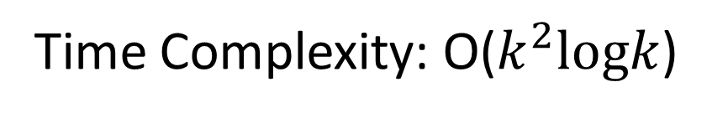
Algorithm KSmallestSums
Input:
Integer k;
k lists: each list has k positive integers;
Output: k smallest sums;
1. Read integer k;
2. Read the first list into array A1;
3. Sort(A1); // in non-decreasing order
4. i=2;
5. while (i <= k) do
6. read the next list into array A2;
7. Sort(A2); // in non-decreasing order
8. Spec-Merge(A1, A2, A1, k); // reuse array A1
9. i=i+1;
10.// end of while
11.Print all the elements of array A1;
Solution
Time Complexity: O($k^{2}logk$)
Space Complexity: O(k)

Slide 23
UVa 11997 Code (1/3)
#include <cstdio>
#include <queue>
#include <algorithm>
using namespace std;
struct Sum {
bool operator<(const Sum & other) const {
return s > other.s;
} // 定義min heap (priority queue)用途
int index, s;
};

Slide 24
int main() {
int k;
freopen("11997.in","r",stdin);
freopen("11997.out","w",stdout);
while (scanf("%d", &k) == 1) {
int ans[999];
for (int i = 0; i < k; i++) scanf("%d", &ans[i]);
sort(ans, ans + k); // 第一個sorted array存於ans
for (int i = 1; i < k; i++) { // 從第二個array開始處理
int b[999];
for (int j = 0; j < k; j++) scanf("%d", &b[j]);
sort(b, b + k);
UVa 11997 Code (2/3)

Slide 25
Spec-Merge(ans, b, ans, k)結果存於ans
UVa 11997 Code (3/3)
priority_queue<Sum> pq;
for (int j = 0; j < k; j++) pq.push((Sum){0, ans[j] + b[0]});
for (int j = 0; j < k; j++) {
Sum sum = pq.top();
pq.pop();
int s = sum.s, index = sum.index;
ans[j] = s; // 得到一個值存起來
if (index + 1 < k) pq.push((Sum){index + 1, s - b[index] + b[index + 1]});
}
}
for (int i = 0; i < k; i++) printf("%d%s", ans[i], i == k - 1 ? "\n" : " ");
}
return 0;
}

